Slide 1

DriverPass System Analysis
Rosalinda Castaneda
Notes:
[No speaker notes required for this slide.]

Slide 2

System Requirements
Functional Requirements:
Users must be able to register, log in, and access learning materials.
Instructors must be able to schedule and manage driving sessions.
Nonfunctional Requirements:
The system must be available 99.9% of the time (high availability).
The platform should load any page within 2 seconds under normal conditions.
Notes:
For DriverPass’s system, I’ve identified both functional and nonfunctional requirements based on the service's needs to support learners and instructors efficiently.
Functional Requirements:
User Authentication and Access to Learning Materials: Users (students) must be able to register, log in securely, and access study resources. This supports the core DriverPass service, which is focused on helping users pass their driving exams through online preparation.
Driving Session Management by Instructors: Instructors need tools to schedule, view, and update driving lessons. This ensures the in-person driving portion of the program is organized and accessible to both instructors and students.
Nonfunctional Requirements:
High Availability (99.9%): Because students and instructors may access the system at various times throughout the day, especially during peak hours, it's important that the platform is reliable and rarely experiences downtime.
Performance (Page Load Speed): Ensuring that web pages load within 2 seconds contributes to a smooth user experience. This prevents user frustration and supports engagement, especially important for young drivers who expect modern, responsive applications.
Together, these requirements are essential for delivering a dependable, user-friendly experience that aligns with DriverPass’s educational and scheduling services.

Slide 3
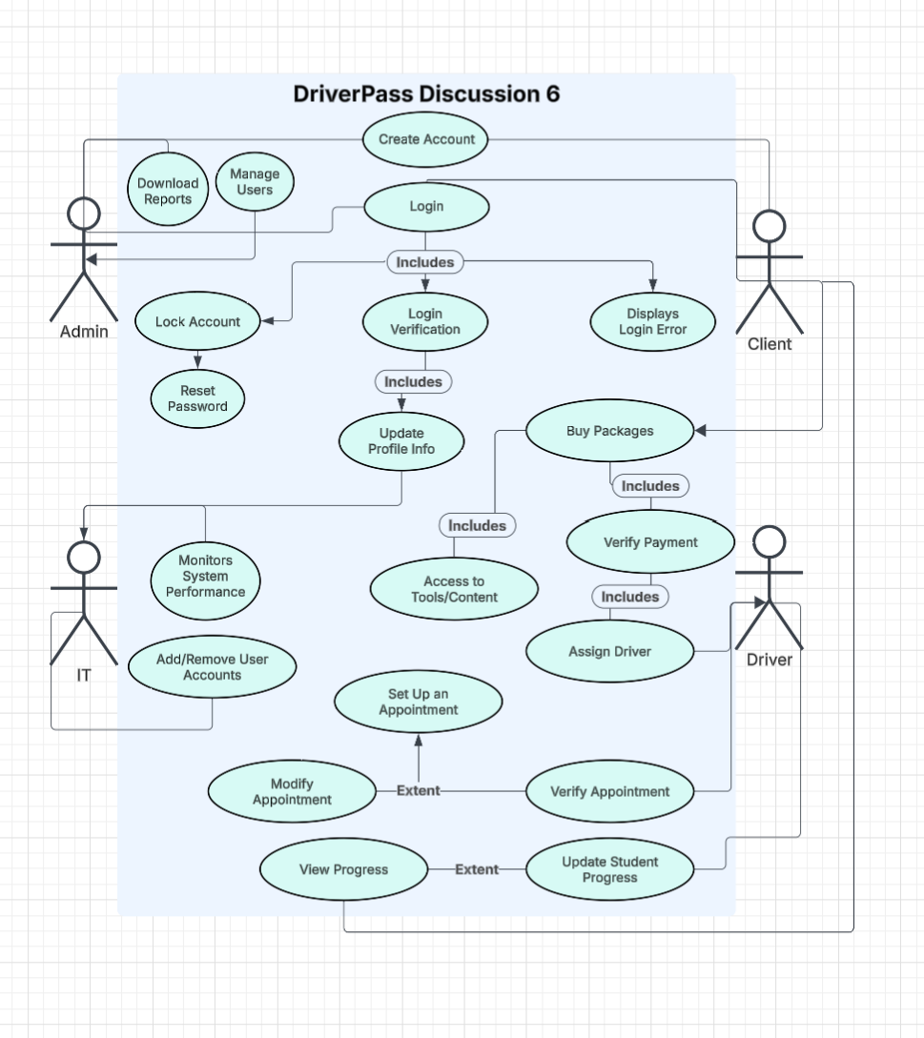
Use Case Diagram
Notes:
This diagram shows how different people interact with the DriverPass system, each with specific responsibilities tailored to their roles.
There are four main types of users:
Admin staff are responsible for system security and management. They handle tasks like downloading reports, managing user access, locking or unlocking accounts, and helping users reset their passwords when needed.
IT team members keep the system running smoothly. They monitor performance and manage user access behind the scenes—adding or removing accounts as necessary.
Clients, or the students using DriverPass, have a full range of capabilities. They can create an account, log in, buy learning packages, update their profile, and use study tools. They can also book, modify, and confirm appointments, and track their learning progress.
Driving instructors (labeled as “Driver” in the diagram) focus on the student’s learning journey. They assign themselves to students, verify scheduled lessons, and update records as students complete their training.
I designed the system with DriverPass’s goals in mind—streamlining the learning process and improving user experience. Each group has access to only what they need, keeping things clear and secure. For example, learners have direct access to educational content and scheduling, while instructors and administrators manage the teaching and operational side.
This clear division helps the system stay organized and efficient, making the process as smooth as possible for everyone involved.

Slide 4
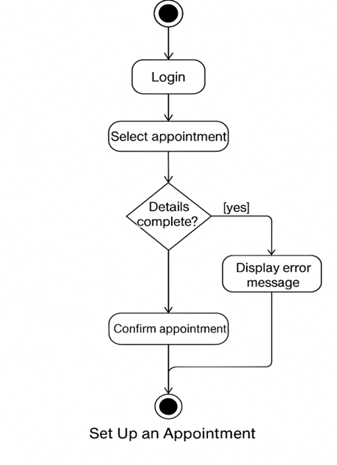
Activity Diagram
Notes:
This diagram shows the step-by-step process a user follows to set up an appointment using the DriverPass system.
The journey begins when the user logs in. From there, they choose the appointment option. Before the system allows them to move forward, it checks whether all the necessary details—like date, time, and location—have been provided. If anything is missing, the user sees an error message and is sent back to make corrections.
Once everything is filled out correctly, the user confirms the appointment, and the system sets it up.
I designed this process with DriverPass’s priorities in mind: making sure that booking an appointment is smooth, but also secure and complete. Requiring all details before confirming helps avoid mistakes and ensures that both learners and instructors have reliable schedules.

Slide 5
Security
How Our Design Addresses Security Concerns:
User accounts are protected with strong passwords.
Personal and payment information is kept private through secure connections.
Only authorized users can access sensitive features (like scheduling).
Regular system checks help prevent unauthorized access.
Notes:
When designing the DriverPass system, we made sure to prioritize the safety and privacy of everyone using it.
First, we require strong passwords for all user accounts to help protect them from being accessed by others.
Second, anytime personal details or payment information are shared—like when someone signs up or pays for a lesson—the system uses safe, encrypted connections to keep that information private.
We also made sure that only the right people can use certain features. For example, only instructors can manage driving sessions, and only students can book their lessons.
Finally, the system is regularly checked and updated to help keep out any unwanted access. While no system is perfect, these steps go a long way in keeping users safe and building trust.

Slide 6
System Limitations
Internet access is required to use most features.
In-person driving sessions depend on instructor availability.
System may experience occasional slowdowns during peak hours.
Limited support for users without smartphones or modern browsers.
Notes:
While the DriverPass system is designed to be helpful and easy to use, it does have a few limitations that users should be aware of.
First, the system relies on a steady internet connection. Without it, users won’t be able to access the online learning materials or manage appointments.
Second, although the system allows you to schedule driving sessions, those appointments still depend on when instructors are available. There might be delays if schedules are full.
Third, during busy times—like evenings or weekends—the system may run a bit slower, which can affect the user experience.
Finally, the platform works best on newer devices and browsers. Those with older phones or outdated technology might face some difficulty using all the features.
We’ll work to improve these areas, but it’s important to be upfront about them so users know what to expect.

